Slide 1

Spreadsheet Project:
AstroSage Analysis
SHUBHAM
10/09/2024

Slide 2
About AstroSage
Keeping this all-embracing vision in mind, renowned astrologer Pt. Punit Pandey embarked AstroSage.com in year 2000 to put astrological wisdom for help of ailing mankind. He is an astute and experienced astrologer himself and understands how different astrological systems like KP, Lal Kitab and Nadi etc can be applied into different situations to get practically viable results. The AstroSage team that works in his guidance consists of many expert astrologers pertaining to different schools of astrology.
AstroSage is one of the most authentic astrology destinations for not only those who are seeking astrological assistance, but also for high-level astrological research and development on wide scale. It is a prolific astrological source for people to help them out from mundane questions to specialized queries. Our aim is to ameliorate those who are facing problems and betterment of humanity using divine science of astrology.

Slide 3

OBJECTIVE
The primary goal of this analysis is to enhance the operational efficiency of the call center, improve agent performance, and increase customer satisfaction.
We focus on key areas like call volume patterns, repeat caller behavior, agent performance, and call resolution efficiency.
The dataset analyzed includes historical call records, agent data, customer information, and performance metrics from the call center operations.
This analysis will help us understand where the call center excels and where improvements can be made.

Slide 4

AstroSage Data Snapshot
Number of Active Gurus: 131 gurus, reflecting the extensive availability.
Geographical Coverage: Since customer can access it online, so its coverage area is almost all over India.
Data Cleaning and Preprocessing
Unified product categories for a consistent classification across the platform.
Normalized guru names for accuracy in analysis.
Addressed missing values in guru name data field to enhance data integrity.
This dataset allows for an in- depth understanding of AstroSage market presence and operational scope.
High-quality data is crucial for analyzing sales trends, customer behavior, and seller performance.

Slide 5

Analytical approach and Tool
Data Cleaning: Utilized functionis like TRIM, CLEAN, and Remove Duplicates to ensure data accuracy.
Data Enrichment: Enhanced the dataset with additional variables using IFElse/ArrayFormulas to cross- reference external data sources.
Descriptive Analysis: Employed Pivot Tables for sümmorizing key metrics and Identifying connection patterns across different metrics and product categories.
Customer Segmentation: Applied SORT and FILTER functions to classify customers based on consultant type and time duration.
Visualization: Created dynamic charts and dashboards for data representation, enabling interactive data exploration.

Slide 6
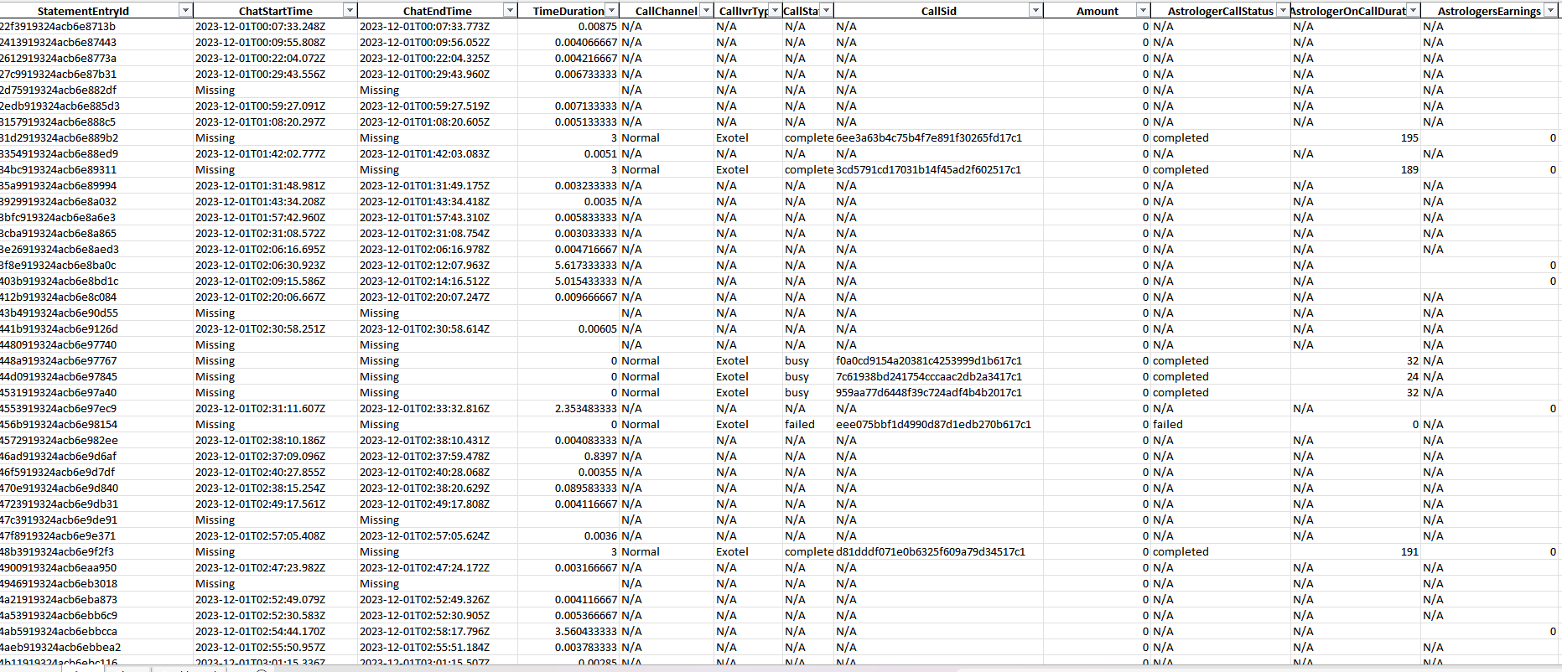
Analytical approach and Tool
Data Cleaned

Slide 7
Objective Analysis
The largest average call volume is on monday, which is representing ~15% of total average call volume.
Tuesday , saturday and Sunday are also an important segment for representing call volume
Also majority of Sales are through call segments and some portion of Chats.
AstroSage should consider implementing technologies and hiring skilled agents to increase the proportion of complementary and public_live_calls.

Slide 8
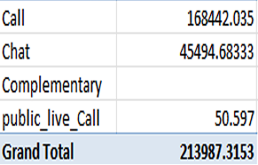
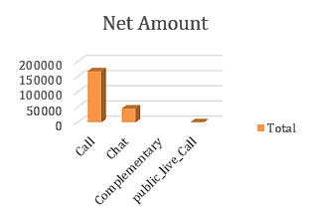
The Total sales generated

Slide 9
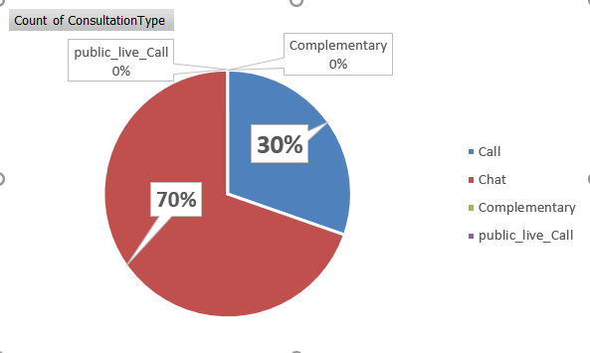

Subjective Analysis
As according to chart we can see that 70% of users prefer chats and 30 % of them are using calls.
And almost negligible amount of users are preferring public_live_call and also AstroSage is providing less complementary call.
So according to analysis AstroSage should provide more amount of complementary calls.
Also more investment can be done in hiring skilled agents and also on implementing Ai-powered chat-bots and CRM technology.
Also a well-designed and systematic feedback system and automatic call routing system will attract more users for calls and overall engagements.

Slide 10
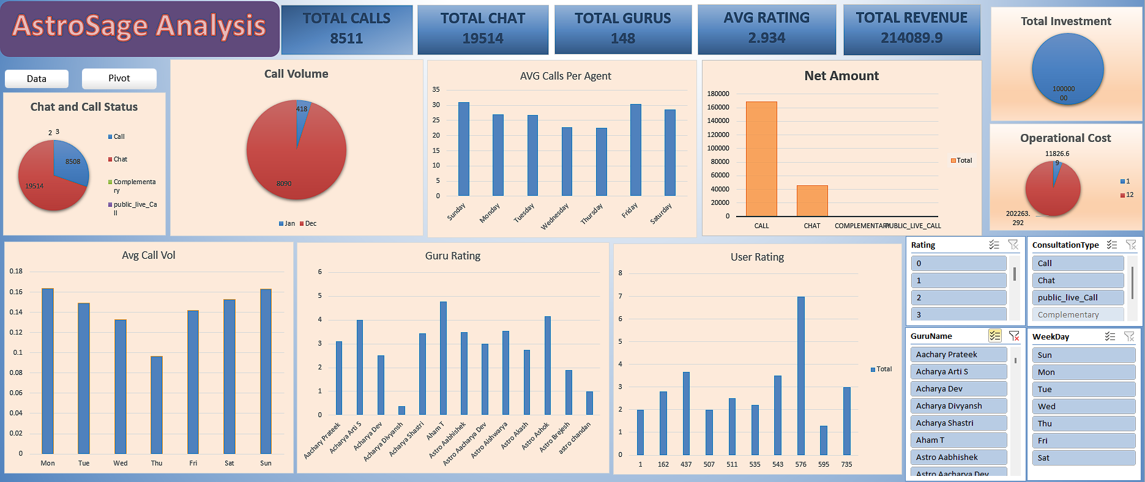
Dashboard

Slide 11
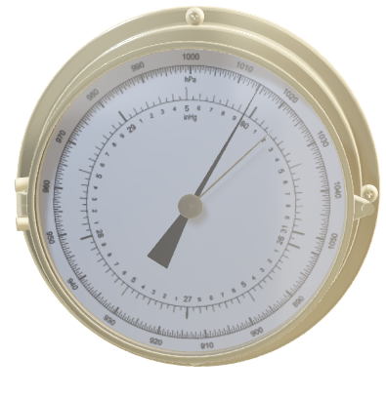
Conclusion
Today, we've explored the performance of AstroSage's call center, revealing valuable insights and identifying opportunities for improvement.
Our analysis has shown that AstroSage is handling large volume of users smoothly and precisely.
However, some of the users are still not satisfied with the AstroSage services due to which average rating is given to this, but we have discussed the solution for that solution with the help of analysis.

Slide 12


References
. Astrosage About Us Page
. Wikipedia
. Newton School Guidelines
. Raw Data

Slide 13


